Slide 1
VISHWAKARMA INSTITUTE OF TECHNOLOGY, PUNE
MIDSEMESTER ASSESSMENT- September 2023
Automated Singulation Using Artificial Intelligence
Div – TY_CS_D GROUP No:- TY67 Day – Friday Date - 01/09/2023
Presented by
Project Guide
7. Sakshee Agrawal
8. Sakshi Jagdale
9. Pranav Salunkhe
10. Raj Salunkhe
Prof. Anant Kaulage
DEPARTMENT OF COMPUTER ENGINEERING

Slide 2
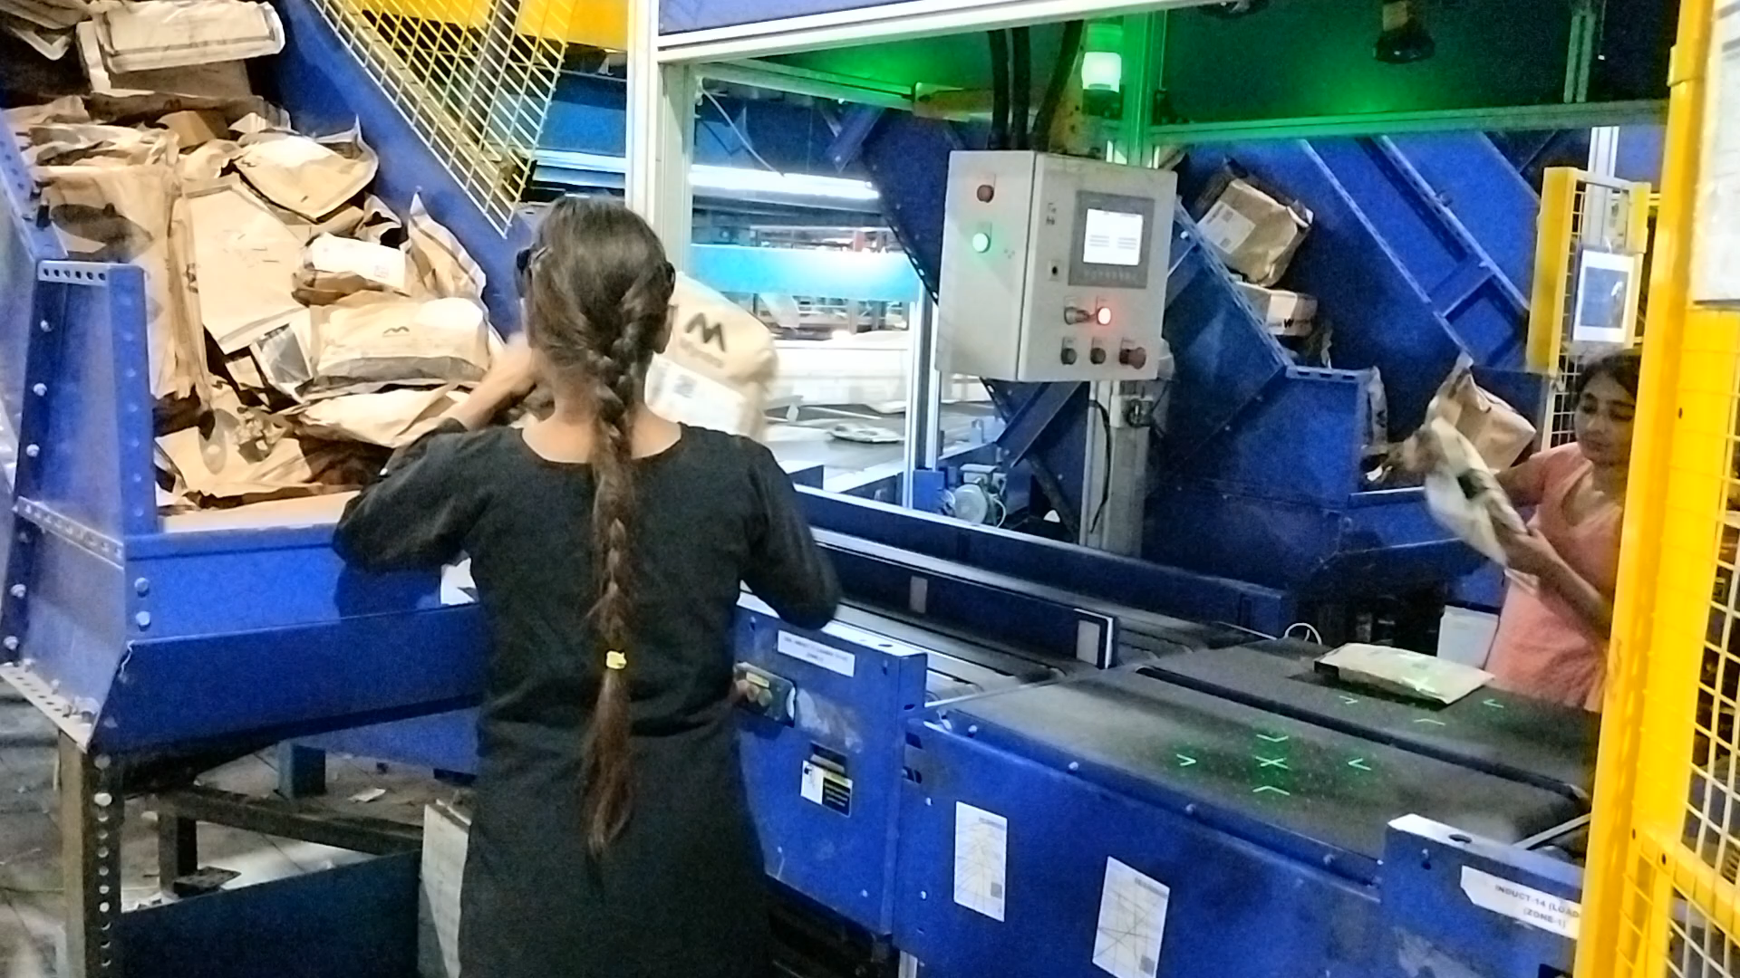
INTRODUCTION
In the realm of e-commerce automation, while complex systems handle much of the process, "Automated Singulation" remains a challenge—separating and placing individual parcels onto conveyor belts for delivery, a crucial task within the context of efficient package sorting and distribution.

Slide 3
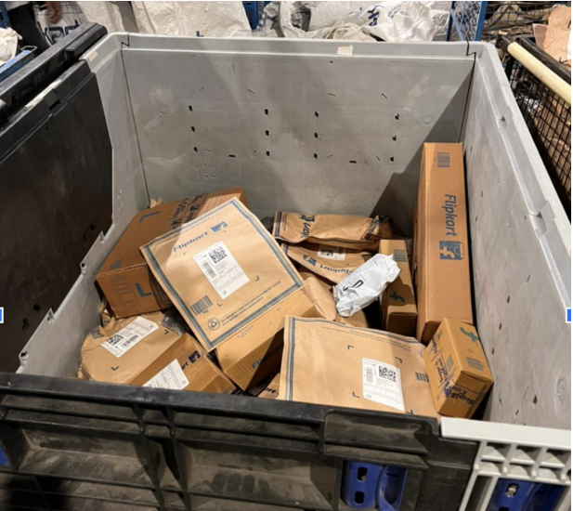
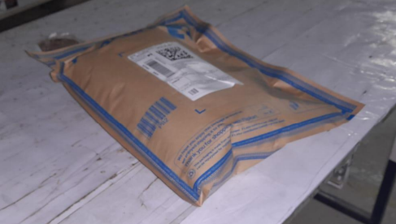
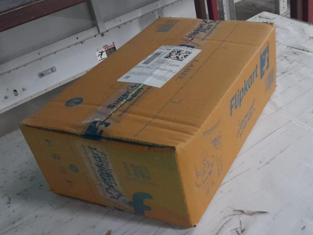
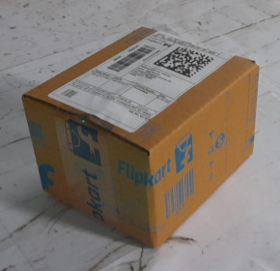
OBJECTIVES
1. Identify and detect individual packages from group of packages / trolley
2. Pick the identified package and drop it in drop zone
3. Make sure that barcode is present on the top

Slide 4
Literature Review
Paper | Description
Split Deep Q-Learning for Robust Object Singulation | The paper introduces "Split DQN" for object singulation in cluttered environments, utilizing lateral pushing policies through reinforcement learning to create grasping space, demonstrated via improved learning rates and adaptable modularity.
Automated Plan Generation for Robotic Singulation from Mixed Bins | The paper proposes a comprehensive approach for successful singulation in bin-picking scenarios by considering various factors, utilizing data-driven methods, and employing a Monte Carlo simulator for plan evaluation.

Slide 5
Literature Review
Paper | Description
A Vision-Guided Robot Manipulator for Surgical Instrument Singulation in a Cluttered Environment | The paper presents a robotic system for precise surgical instrument singulation using vision-based identification and a compliant electromagnetic gripper, validated through experiments.
A Summary of Team MIT’s Approach to the Amazon Picking Challenge 2015 | The paper outlines Team MIT's approach in the Amazon Picking Challenge 2015, detailing their robotic system design, including a custom end-effector, perception and motion planning, while reflecting on challenges faced and lessons learned.

Slide 6
Literature Review
Paper | Description
Design and Development of Robot Arm System for Classification and Sorting Using Machine Vision | The paper presents an automated method utilizing low pressure suction grippers to separate air-permeable sheets from a stack, employing differential pressure sensor data for control, achieving successful singulation of stacked materials and suggesting potential enhancements through the integration of multiple sensor principles.
Automated Stack Singulation for Technical Textiles Using Sensor Supervised Low Pressure Suction Grippers | The paper presents an automated approach using low-pressure suction grippers and differential pressure sensors for singulating air-permeable sheets, achieving a high success rate in separating stacked materials, and suggests potential enhancements through the integration of diverse sensor principles.

Slide 7
PROPOSED SYSTEM AND METHOLOGY

Slide 8
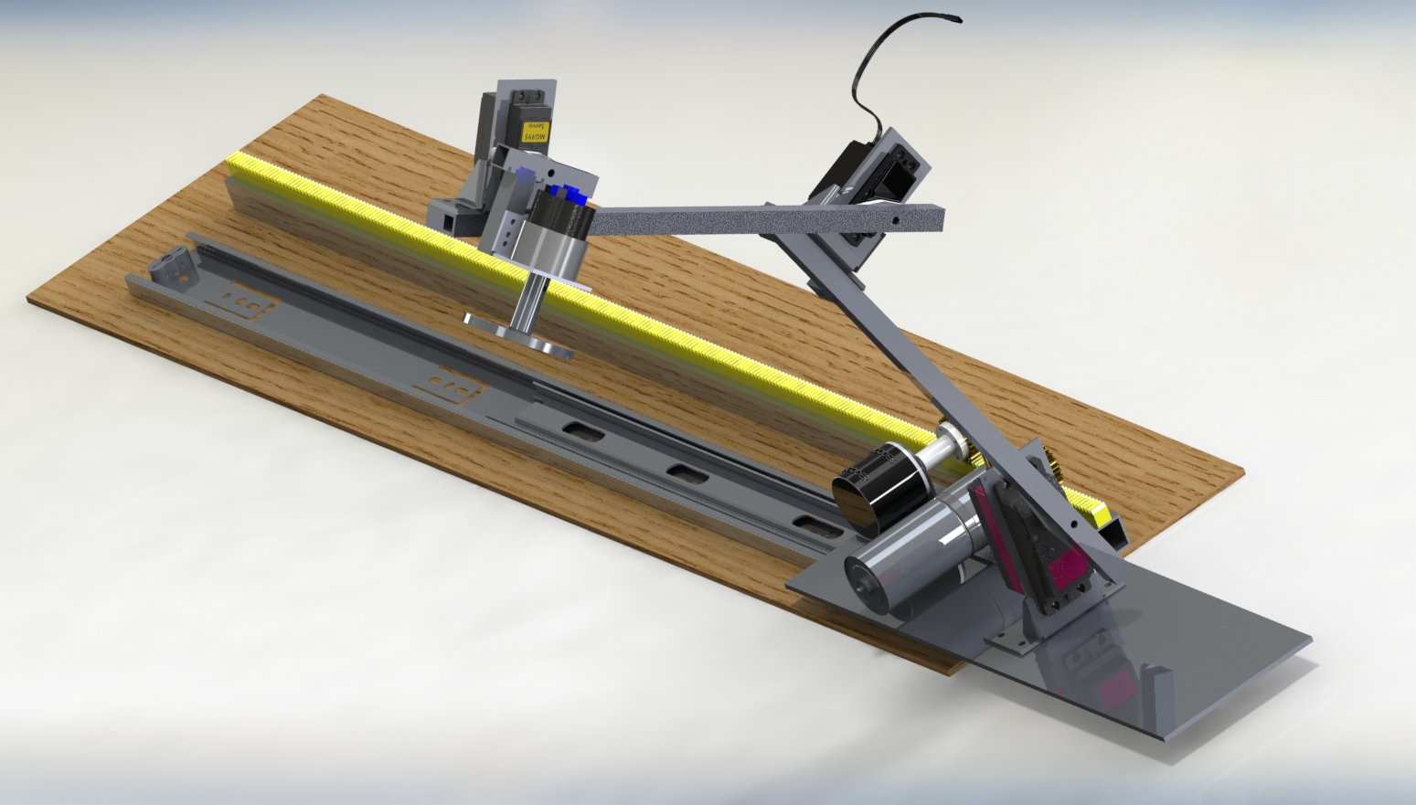
PROPOSED MODEL
Servo
Servo
Motor
Motor
Servo

Slide 9
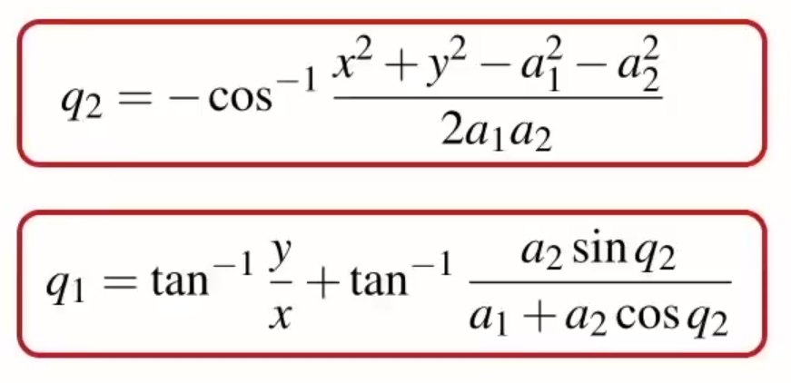
Mapping of Servo Using Kinematics
q2
a2
a1
q1

Slide 10
DATA FLOW DIAGRAM

Slide 11
Servo 1
Servo 2
Servo 3
Camera 1
R.O.S.
Arduino Board
Camera 2
Motor driver
Pump motor control
ARCHITECTURE
Motor 1
Motor 2

Slide 12
Camera 1
ROS
Node 1
Central Node
Node 2
Node 3
Camera 2
Arduino

Slide 13
Challenges
Identifying packages which are kept in jumbled manner
Packages design are so simple that feature extraction is not easy
Solution – using objection detection along with image processing and trying more combinations
Picking package
Delivery packages not only include boxes of varying sizes but also include flyer packages
Solution – Using suction gripper

Slide 14
CONCLUSION
Project addresses e-commerce's automated singulation challenge.
Developed a system for precise package detection, picking, and label orientation.
Promises increased efficiency and reduced labor in e-commerce sorting.
Offers a glimpse into the future of automation in the industry.
Anticipates cost savings and improved customer service as a result.

Slide 15
REFERENCES
Sarantopoulos, M. Kiatos, Z. Doulgeri, and S. Malassiotis, “Split Deep Q-Learning for Robust Object Singulation,” in 2020 IEEE International Conference on Robotics and Automation (ICRA), 2020, pp. 1-6. doi: 10.1109/ICRA40945.2020.9196647
N. Kaipa, S. Shriyam, A B. Kumbla, and R K. Gupta, “Automated Plan Generation for Robotic Singulation from Mixed Bins,” in IROS Workshop on Task Planning for Intelligent Robots in Service and Manufacturing, 2015.
“A Vision-Guided Robot Manipulator for Surgical Instrument Singulation in a Cluttered Environment,” in 2014 IEEE International Conference on Robotics and Automation (ICRA), 2014, pp. 1-6. doi: 10.1109/ICRA.2014.6907366
A.Zeng, K. Yu, S. Song, D. Suo, E. Walker Jr., A. Rodriguez, and J. Xiao, “A Summary of Team MIT’Approach to the Amazon Picking Challenge 2015,” Journal of Field Robotics, vol. 33, no. 4, pp. 423-439, 2016.
Vo Duy Cong, Le Duc Hanh, Le Hoai Phuong, and Dang Anh Duy. “Design and Development of Robot Arm System for Classification and Sorting Using Machine Vision.” FME Transactions, 2022 .
B. Wirth, T. Schwind, M. Friedmann and J. Fleischer, “Automated Stack Singulation for Technical Textiles Using Sensor Supervised Low Pressure Suction Grippers,” in Annals of Scientific Society for Assembly, Handling and Industrial Robotics, 2022.
Imran, Abid, Sang-Hwa Kim, Young-Bin Park, Il Hong Suh, and Byung-Ju Yi. 2019. "Singulation of Objects in Cluttered Environment Using Dynamic Estimation of Physical Properties" Applied Sciences 9, no. 17: 3536. https://doi.org/10.3390/app9173536

